Slide 1

Blazor in .net 8

Slide 2
Agenda
Blazor Web App
Introduction
Render Mode
LifeCycle
PreRender
New Feature
Webcil packaging
Add CascadingValue
Inject keyed services
Route to named elements
DataBinding
Form
Sections
Virtualize empty content

Slide 3
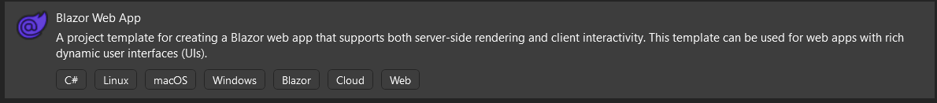
Blazor Web App
Introduction
Blazor Web is a full-stack web UI framework that render content at either the component or page level with:
Static server rendering to generate static HTML.
Interactive Server rendering.
Interactive WebAssembly rendering.
Interactive Auto (automatic) rendering.
https://learn.microsoft.com/en-us/aspnet/core/release-notes/aspnetcore-8.0?view=aspnetcore-8.0#full-stack-web-ui

Slide 4
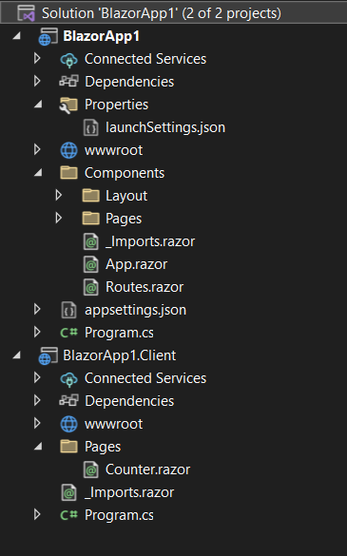
Blazor Web App
Introduction
The components in the server is in the solution's project Components/Pages folder.
The components in the client is in the solution's project Pages folder with a name that ends in .Client.
// Add services to the container.
// Add services to support rendering Interactive Server and WebAssembly components.
builder.Services.AddRazorComponents()
.AddInteractiveServerComponents()
.AddInteractiveWebAssemblyComponents();
//......
app.MapRazorComponents<App>()
.AddInteractiveServerRenderMode()
.AddInteractiveWebAssemblyRenderMode()
.AddAdditionalAssemblies(typeof(Counter).Assembly);

Slide 5
Blazor Web App
Render Mode
Name | Description | Render location | Interactive
Static | Static server rendering | Server | ❌
Interactive Server | Interactive server rendering using Blazor Server | Server | ✔️
Interactive WebAssembly | Interactive client rendering using Blazor WebAssembly | Client | ✔️
Interactive Auto | Interactive client rendering using Blazor Server initially and then WebAssembly on subsequent visits after the Blazor bundle is downloaded | Server, then client | ✔️
https://learn.microsoft.com/en-us/aspnet/core/blazor/components/render-modes?view=aspnetcore-8.0#render-modes

Slide 6
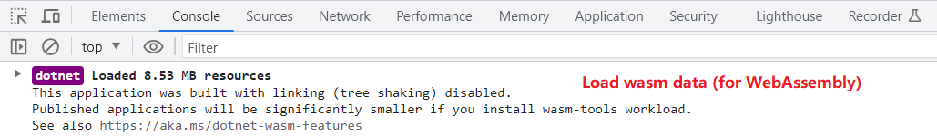
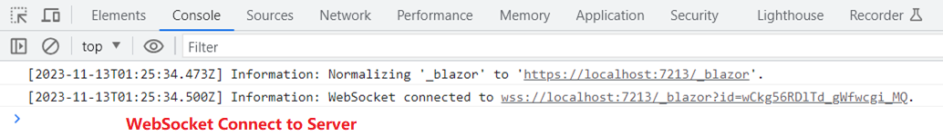
Blazor Web App
Render Mode
WebAssembly
Server

Slide 7
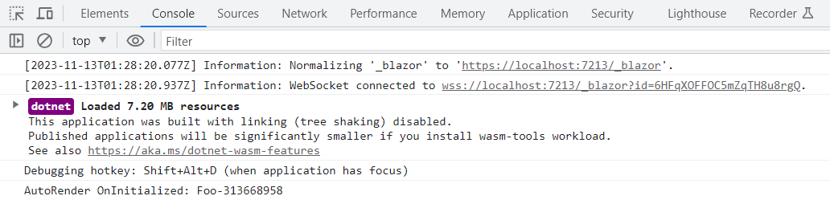
Blazor Web App
Render Mode
Auto

Slide 8
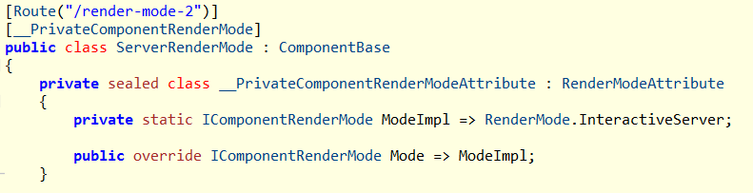
Blazor Web App
Render Mode
Component will generate a private __PrivateComponentRenderModeAttribute which distingulish the RenderMode:
@page "/render-mode-2"
@rendermode RenderMode.InteractiveServer
<h3>Server Render Mode</h3>

Slide 9
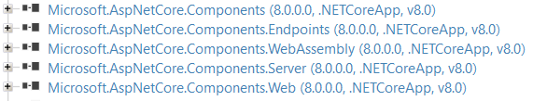
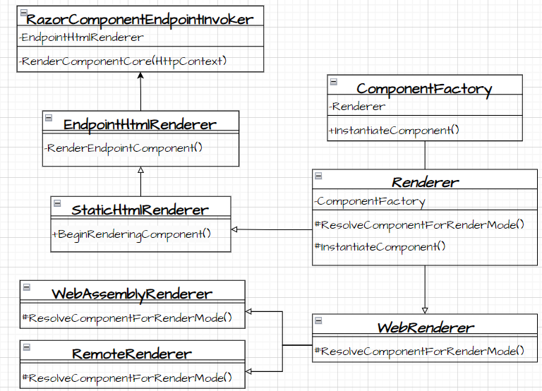
Blazor Web App
Render Mode
Render Componment:
RazorComponentEndpointInvoker.cs
RazorComponentEndpointInvoker.RenderComponentCore():
1. Initialize StreamingRendering Framing
2. Initialize Standard Component Services
3. Render Endpoint Component
3.1 InstantiateComponent
3.1.1 ResolveComponentForRenderMode
3.2 Waiting for quiesence(none stream Rendering) complete
4. write by HttpResponseStreamWriter

Slide 10
Blazor Web App
Render Mode
Render Componment:
RazorComponentEndpointInvoker.cs
RazorComponentEndpointInvoker.RenderComponentCore ->
EndpointHtmlRenderer.InitializeStandardComponentServicesAsync
EndpointHtmlRenderer.RenderEndpointComponent->
BeginRenderingComponent->
ComponentFactory.InstantiateComponent
WaitForResultReady() wait for quiescence of the non-streaming subtrees
EndpointHtmlRenderer.PrerenderPersistedStateAsync ->
return ComponentStateHtmlContent with different PrerenderComponentApplicationStore
Write by HttpResponseStreamWriter

Slide 11
Blazor Web App
Create Component:
ComponentFactory.cs
ComponentFactory.InstantiateComponent
Renderer.ResolveComponentForRenderMode -> override by EndpointHtmlRenderer/WebAssemblyRenderer : WebRenderer / RemoteRenderer : WebRenderer
->IComponentActivator.CreateInstance ->Implement by DefaultComponentActivator
->PrerenderPersistedStateAsync
RazorComponentEndpointInvoker.RenderComponentCore ->
EndpointHtmlRenderer.RenderEndpointComponent->
…-> ComponmentFactory.InstantiateComponent

Slide 12
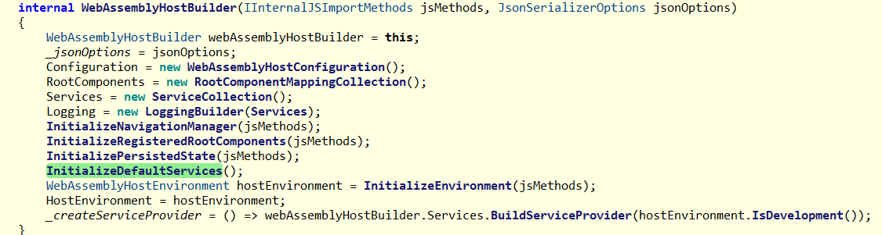
Blazor Web App
WebAssemblyHostBuilder.cs

Slide 13
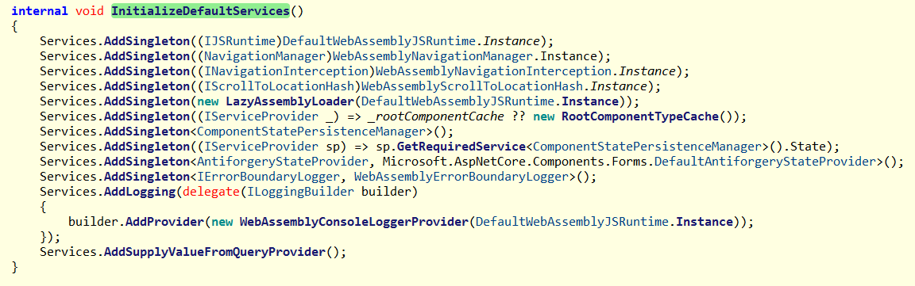
Blazor Web App

Slide 14
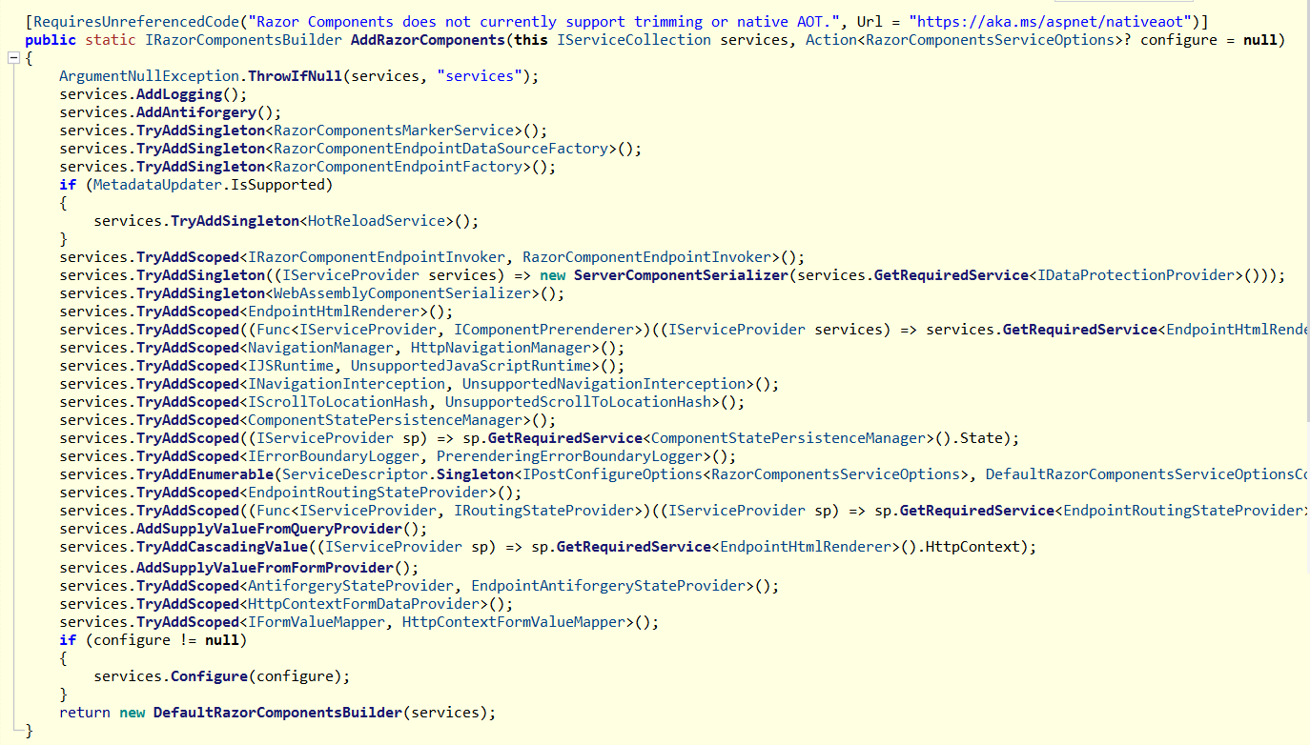

Slide 15
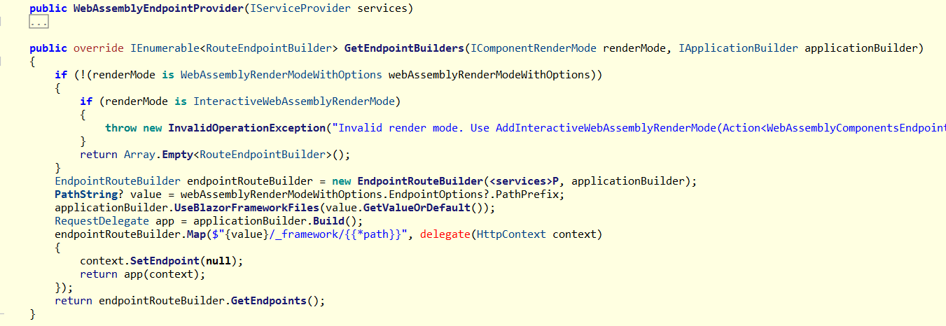
WebApplicationBuilder
AddInteractiveWebAssemblyComponents

Slide 16
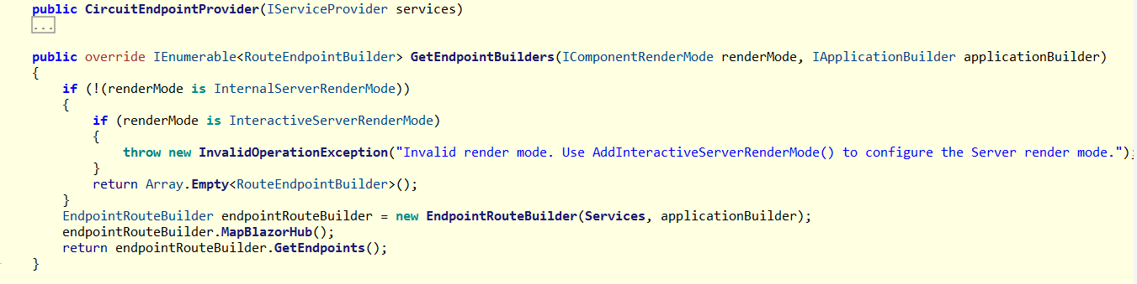
AddInteractiveServerComponents

Slide 17
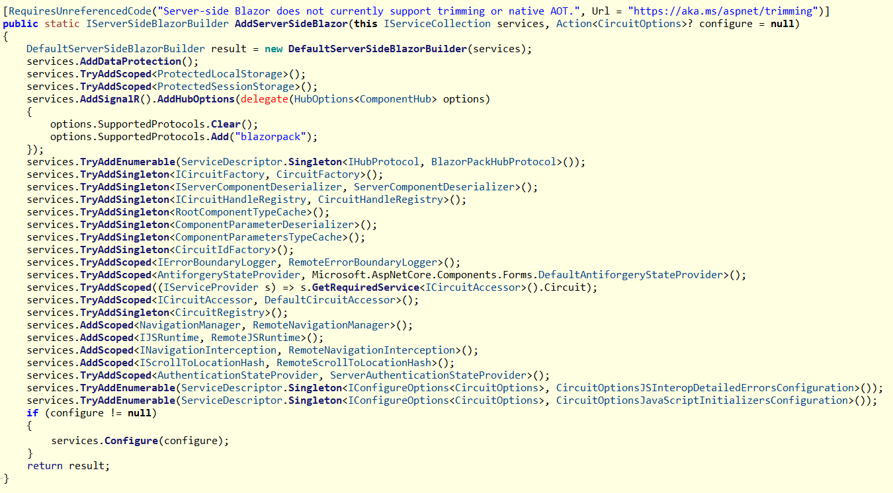

Slide 18
Blazor Web App
Life Cycle
ASP.NET Core Razor component lifecycle
.net 6.0/8.0 Blazor Server/WebAssembly App | .net 8.0 Blazor Web App Server/WebAssembly/Auto Mode | .net 8.0 Blazor Web App Static Mode
SetParametersAsync - Begin OnInitialized OnInitializedAsync OnParametersSet OnParametersSetAsync SetParametersAsync - End | SetParametersAsync - Begin OnInitialized OnInitializedAsync OnParametersSet OnParametersSetAsync SetParametersAsync – End SetParametersAsync - Begin OnInitialized OnInitializedAsync OnParametersSet OnParametersSetAsync SetParametersAsync – End | SetParametersAsync - Begin OnInitialized OnInitializedAsync OnParametersSet OnParametersSetAsync SetParametersAsync - End
SSR (Server Side Rendering)

Slide 19
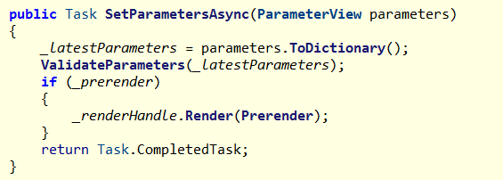
Blazor Web App
PreRender
Blazor apps that prerender their content on the server call SetParametersAsync twice
Prerender at SSRRenderModeBoundary.cs
Set @attribute [RenderModeInteractiveWebAssembly(prerender: false)]/@attribute [RenderModeInteractiveServer(prerender: false)] / @attribute [RenderModeInteractiveAuto(prerender: false)] will disable prerender

Slide 20
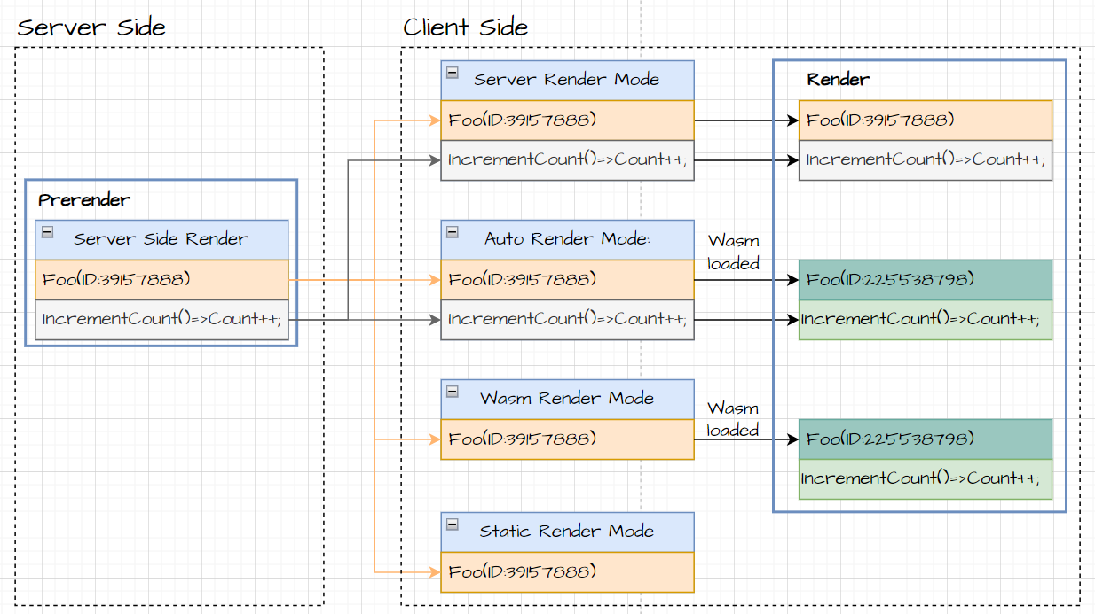
Blazor Web App
PreRender
PreRender enabled and rendering at server side

Slide 21
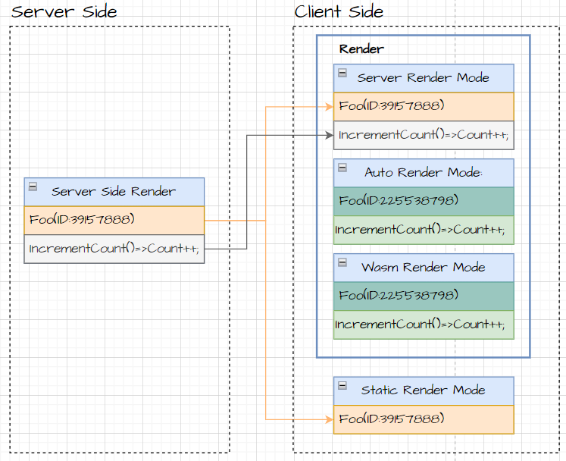
Blazor Web App
PreRender
PreRender Disabled

Slide 22
New Features
Feature | Detail | Hosting Support
 |  | Web | WebAssembly | Server(7.0)
Webcil packaging | Published with .wasm instead of .dll file | ✔️ | ✔️ | ❌
DataBinding | Two way binding: @bind:get/set | ✔️ | ✔️ | ✔️
Add CascadingValue | Root-level cascading values | ✔️ | ✔️ | ❌
Inject keyed services | Inject keyed services into components | ✔️ | ✔️ | ❌
Route to named elements | Navigation.NavigateTo("/counter#targetElement"); | ✔️ | ✔️ | ✔️
Form | AntiforgeryToken | ✔️ | ✔️ | ✔️
 | SupplyParameterFromFormAttribute | ✔️ | ✔️ | ✔️
 | Enhanced form handling | ✔️ | ✔️ | ✔️
Sections | Sections support | ✔️ | ✔️ | ❌
Virtualize empty content | Virtualize with empty content | ✔️ | ✔️ | ❌

Slide 23
New Features
Feature | Detail | Hosting Support
 |  | Web | WebAssembly | Server(7.0)
Quick Grid | Blazor QuickGrid component from .net 7 | ✔️ | ✔️ | ✔️
Dialog | Support for dialog cancel and close events | ✔️ | ✔️ | ✔️
Handle errors | Use ComponentBase.DispatchExceptionAsync | ✔️ | ✔️ | ✔️
 | Use IHostEnvironment | ✔️ | ❌ | ✔️
Stream Rendering | StreamRenderingAttribute | ✔️(Server) | ❌ | ❌
Error Page | Default errorpage: /Pages/Error.razor | ✔️ | ❌ | ✔️
HttpContext cascading parameter | HttpContext as a cascading parameter | ✔️(static) | ❌ | ❌
Render outside asp .net core | Render Razor components outside of ASP.NET Core | - | - | -
https://learn.microsoft.com/en-us/aspnet/core/release-notes/aspnetcore-8.0?view=aspnetcore-8.0#blazor

Slide 24
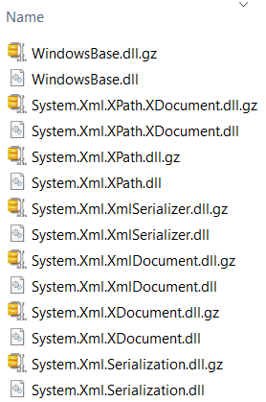
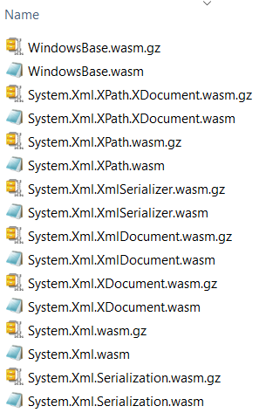
New Features
Webcil packaging
Webcil files use a standard WebAssembly wrapper, where the assemblies are deployed as WebAssembly files that use the standard .wasm file extension instead of .dll file.
Output at wwwroot\_framework
https://github.com/dotnet/runtime/blob/main/docs/design/mono/webcil.md
.net 6.0
.net 8.0

Slide 25
New Features
Add CascadingValue
Root-level cascading values can be registered for the entire component hierarchy.
Named cascading values and subscriptions for update notifications are supported.
AddCascadingValue LifeCycle is Scoped
builder.Services.AddCascadingValue(provider => new Foo { Name = "Cascading Foo" });
builder.Services.AddCascadingValue("Alpha", sp => new Foo { Name = "Cascading Alpha Foo" });
@code {
[CascadingParameter]
public Foo? Foo { get; set; }
[CascadingParameter(Name = "Alpha")]
public Foo? AlphaFoo { get; set; }
}

Slide 26
New Features
Route to named elements
Navigate to a named element using the following approaches with a hashed (#) reference to the element.
Navigation.NavigateTo("/counter#targetElement");
Will Navigate to Element: <h2 id="targetElement"> in /counter page
<div class="border border-info rounded bg-info" style="height:500px"></div>
<h2 id="targetElement">Target H2 heading</h2> <p>Content!</p>
Inject keyed services
Blazor now supports injecting keyed services using the [Inject] attribute.
builder.Services.AddKeyedSingleton<WeatherForecastService>("forecast-service");
[Inject(Key = "forecast-service")]
public WeatherForecastService ForecastService { get; set; }

